Slide 1


Welcome to the ECSA Region Prescribing and Medicines Management Webinar
Introduce yourself!
What to expect
Cameras & microphones will remain off - please use the chat function to ask questions!
This session will be recorded, and some names of viewers may be visible in the recording.
We’d love your feedback! Use the link we’ll share in the chat to help us improve future webinars.
Use the chat function to tell us who you are, and where you are from!

Slide 2
Prescribing and Medicines Management:
Opportunities to Strengthen Multidisciplinary Collaboration in Primary Care Across the ECSA Region
AFREhealth | ECSA Health Community | Commonwealth Pharmacists Association
Wednesday 13th May 2026

Slide 3
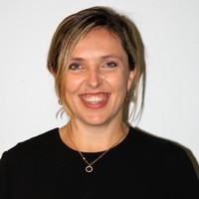
Beth Ward
BPharm MSc MBA (Health) FRCPharm
Strategic Lead:
Workforce Capability Building
Commonwealth Pharmacists Association
United Kingdom
Co-Moderator

Slide 4
Housekeeping Reminder
Microphones will remain muted
Cameras will remain off
Questions: We encourage active participation. If you have any questions, please type them in the chat box and we will do our best to get to them.
Survey: We will put an anonymous feedback survey in the chat box towards the end of this session. Please complete this survey so that we can continue to improve our webinar content in future.
Recording and Confidentiality: This webinar is being recorded for future reference and may be shared publicly.

Slide 5
Established in 1969,
The Commonwealth Pharmacists Association (CPA) is a registered charity, an Accredited Organisation of the Commonwealth and in official relations with the World Health Organisation (WHO).
As the international body of the Commonwealth’s national pharmacy associations, we represent over 1 million pharmacists on the global stage.
Our vision is to advance equitable access to safe and effective medicines and pharmacy services for a healthier world.
We pursue this through our efforts to build capability in the health workforce, strengthen health systems, and advocate for patients and the profession.

Slide 6
Today’s Agenda
Welcome
Setting the scene: Why prescribing capacity matters in Africa
Education and workforce development perspectives
Country case studies
Moderated panel discussion
Audience Q&A
Closing Remarks

Slide 7
Prescribing and Medicines Management Webinar
Aims
Objectives
Share current practice
Identify training and continuing professional development (CPD) needs
Scope opportunities for multidisciplinary team collaboration
Inform the UK - East, Central and Southern Africa (ECSA) multi-professional workforce project
Strengthen dialogue between pharmacy and nursing professions.
Share practical examples of prescribing practice in African health systems.
Identify priority areas for workforce training and development.
Highlight regulatory and policy considerations.
Generate insights to inform future collaborative programmes.

Slide 8
Why Prescribing Capacity Matters in Africa
Commonwealth Pharmacists Association

Slide 9
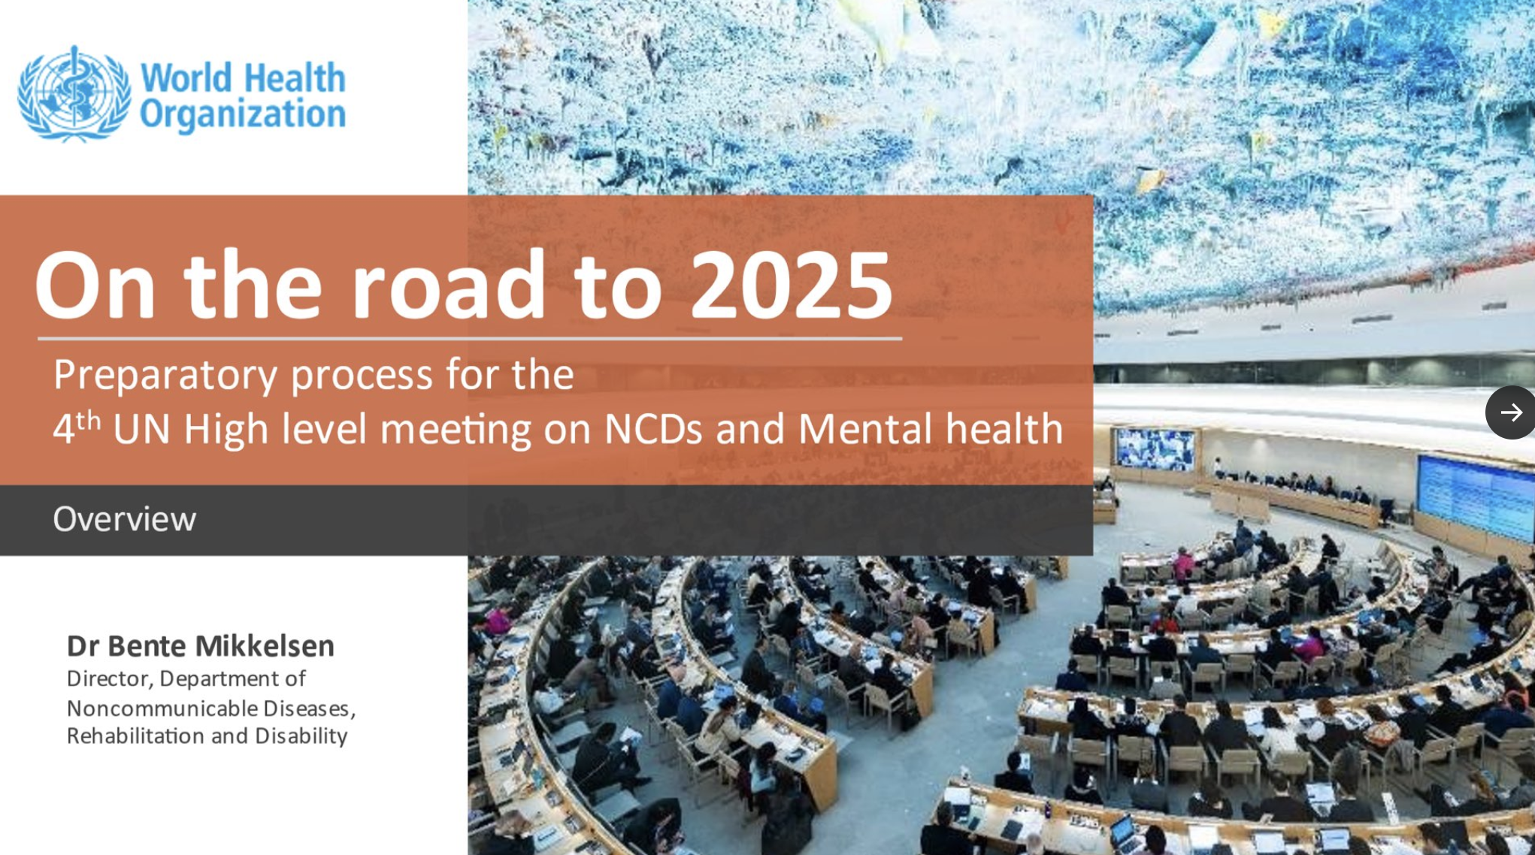
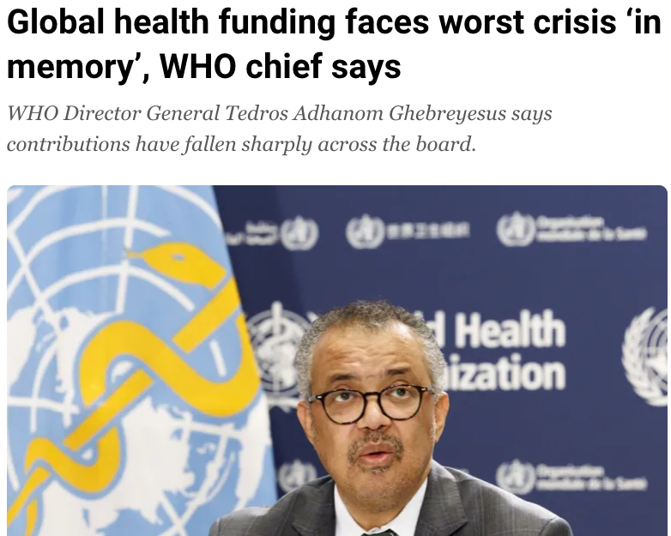

Current Global Health Policy Landscape
Notes:
We welcome the zero draft of the Political Declaration for the 2025 UN High-Level Meeting on Non-Communicable Diseases (NCDs) and commend the recognition of primary health care, medicines access, and workforce strengthening as central pillars of the NCD response - all of which, pharmacists are central to - working as part of the MDT.

Slide 10
Shift from Treatment to Prevention and Self-Care
Treatment
Prevention
Secondary
Primary
The key to reversing the growing burden on health systems is:
Prevention
Early detection…
…and management through primary care that is:
Integrated
Multisectorial
Community centred
Notes:
https://www.who.int/news-room/commentaries/detail/primary-health-care--a-scalable-solution-to-the-noncommunicable-diseases-and-mental-health-crisis
The global health and equity crisis of NCDs and mental health is so vast that deciding how to respond can seem overwhelmingly complex.
The best starting point however is no mystery.
The primary health care approach is a globally scalable and holistic approach that holds power to lessen the NCD and mental health burden and improve the lives of billions.
Integrated - effective, accessible, affordable - breaking down traditional silos between different healthcare settings and professionals to ensure seamless and efficient care delivery.
Multisector
Country ownership, people centred
NCDs are preventable - focussing on prevention reduces the incidence of diseases before they even start
Cost-effectiveness - prevention is more economical than treatment and reduces both direct (treatment associated) and indirect costs (productivity). Treatment of NCDs often involves costly long-term medication, hospital stays, surgeries, and specialist care. Prevention (e.g., promoting healthy lifestyles, early screening/POCT) reduces both direct healthcare costs and indirect costs (like lost productivity).
Reduces health system burden - Prevention frees up resources for other health needs, reduces hospital admissions and avoids system overload, especially in low-resource settings. NCDs account for the majority of healthcare use globally.
Improves quality of life - Prevention avoids chronic disease and disability and enables people to live longer healthier lives
Addresses root causes - Treatment manages symptoms rather than addressing underlying cause of disease
Equity and long term impact - Prevention interventions and strategies can reduce health inequalities, creating sustainable, generational impact

Slide 11
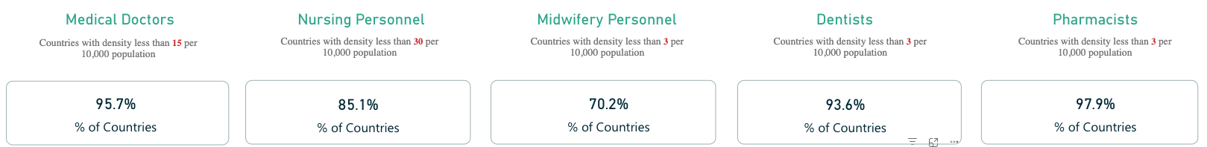
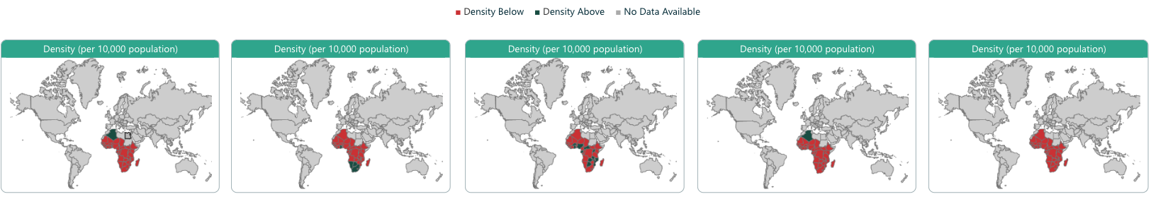
Africa: Health Workforce Picture
WHO National Health Workforce Accounts Data Portal – Accessed 1st Dec 2025
Notes:
We all know the urgency of the global health and care workforce shortage…and the predicted 18 million shortfall in health workers by 2030
LMICs are disproportionately affected by such shortages, and as we see from the map this includes Ghana.
It is therefore imperative to maximise the use of full MDT
This further emphasises the massive opportunity to capitalise on the skills / experience of the full MDT, including pharmacists

Slide 12

Harnessing the Full Power of the Team

Slide 13
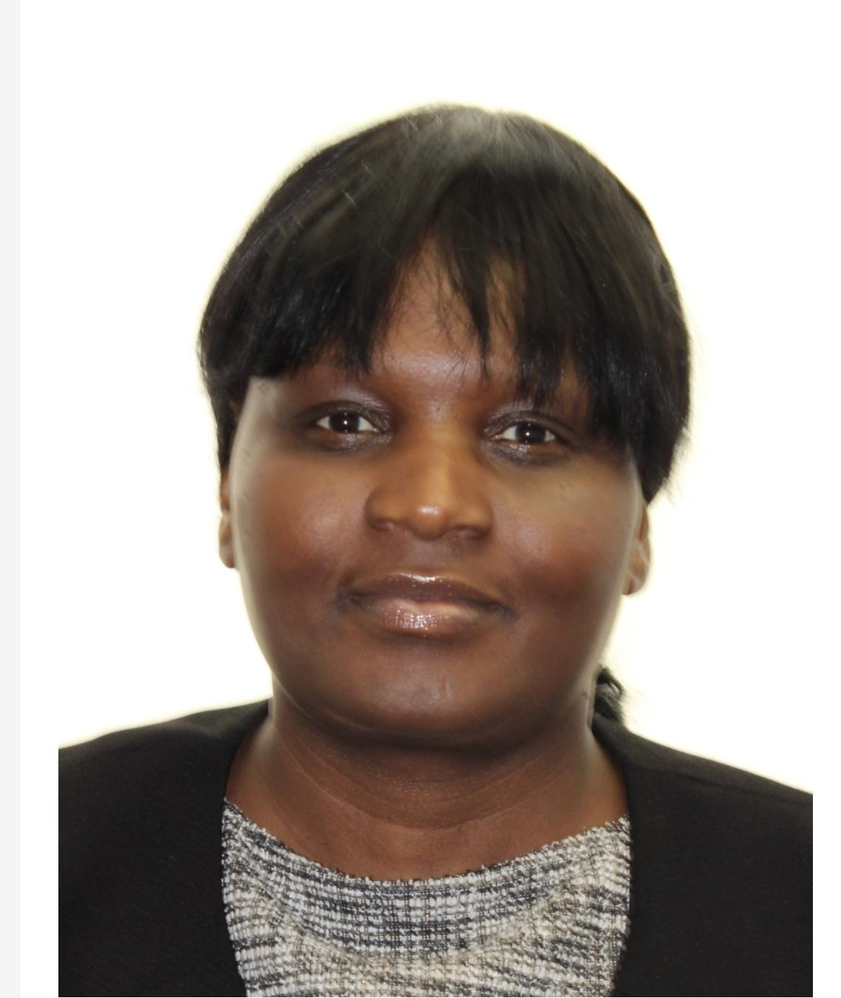


Bongi Sibanda
Corporate Lead Advanced Practitioner Prescribing Lead - NMAHPPs
Centre for NMAHP Research and Education Excellence (CeNREE), University Hospitals of North Midlands NHS Trust
United Kingdom
Co-Moderator

Slide 14

Background
“Everything rises and falls on Leadership” - Dr John Maxwell
Definitions: Multiprofessional vs. Interprofessional (education, learning and leadership).
One of the largest teaching trusts in the country, primarily serving patients in Staffordshire and Stoke-on-Trent and a tertiary centre (North Midlands & North Wales).
International reputation in research and innovation (Appreciative Inquiry).
Multiprofessional advanced practice education, supervision and leadership research findings (mixed-methods sequential explanatory design: Queen’s University Belfast 2023), including Health Education England (NHS England London)-funded projects 2021-2023.
Autoethnography research 2014-2024 (including Africa Interprofessional Education Network and African Forum for Primary Health Care (AfroPHC) board leadership roles; the Anglophone Africa Advanced Practice Nurse Coalition & Family Nurse Practitioner Curriculum Framework Project 2016-2021) – Global health professions educational leadership, innovation and policy – University of Greater Manchester.
Advancing practice educator workforce (enhanced, advanced & consultant level of practice) including IEHWs-IMGs/IENMs/AHPs at NHS University Hospitals of North Midlands NHS Trust (UHNM).

Slide 15
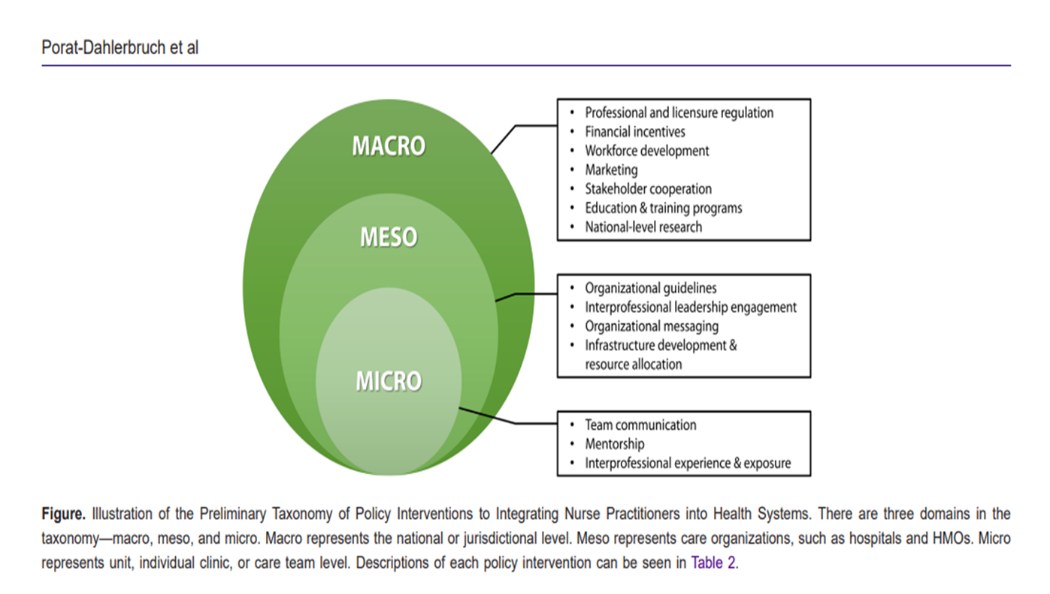
Evidence–Informed Integration in Advancing Practice & Prescribing Workforce Development
UHNM lessons for UK-Global Project (Health Professions Educator Workforce)
Porat-Dahlerbruch, J., Ratz, S., Ellen, M. (2024). 'Development of a Taxonomy of Policy Interventions for Integrating Nurse Practitioners into Health Systems', International Journal of Health Policy and Management, 13(1), pp. 1-11. doi: 10.34172/ijhpm.2023.8194

Slide 16
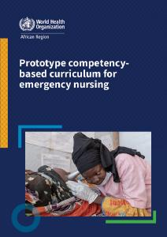
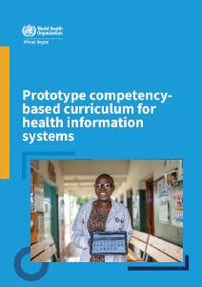
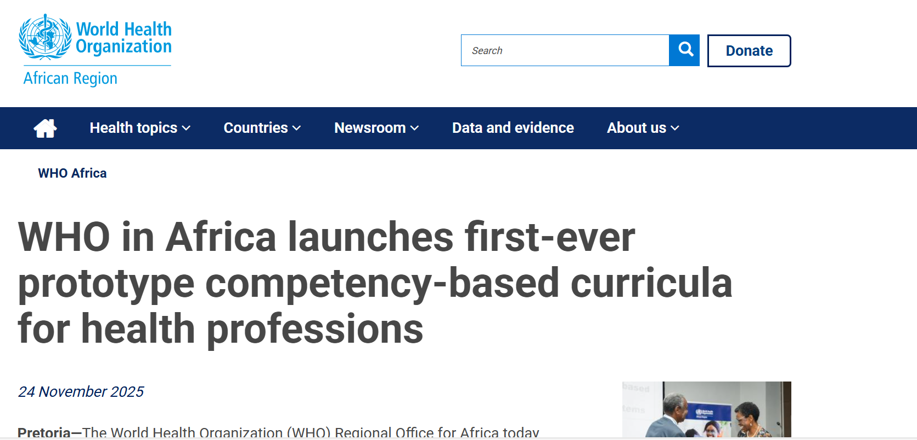
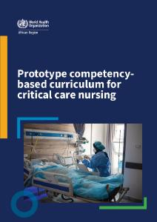

Africa Leading the Way in Health Professions
Education Reform
Competency-Based Curricula Prototypes
(WHO 2025)

Slide 17
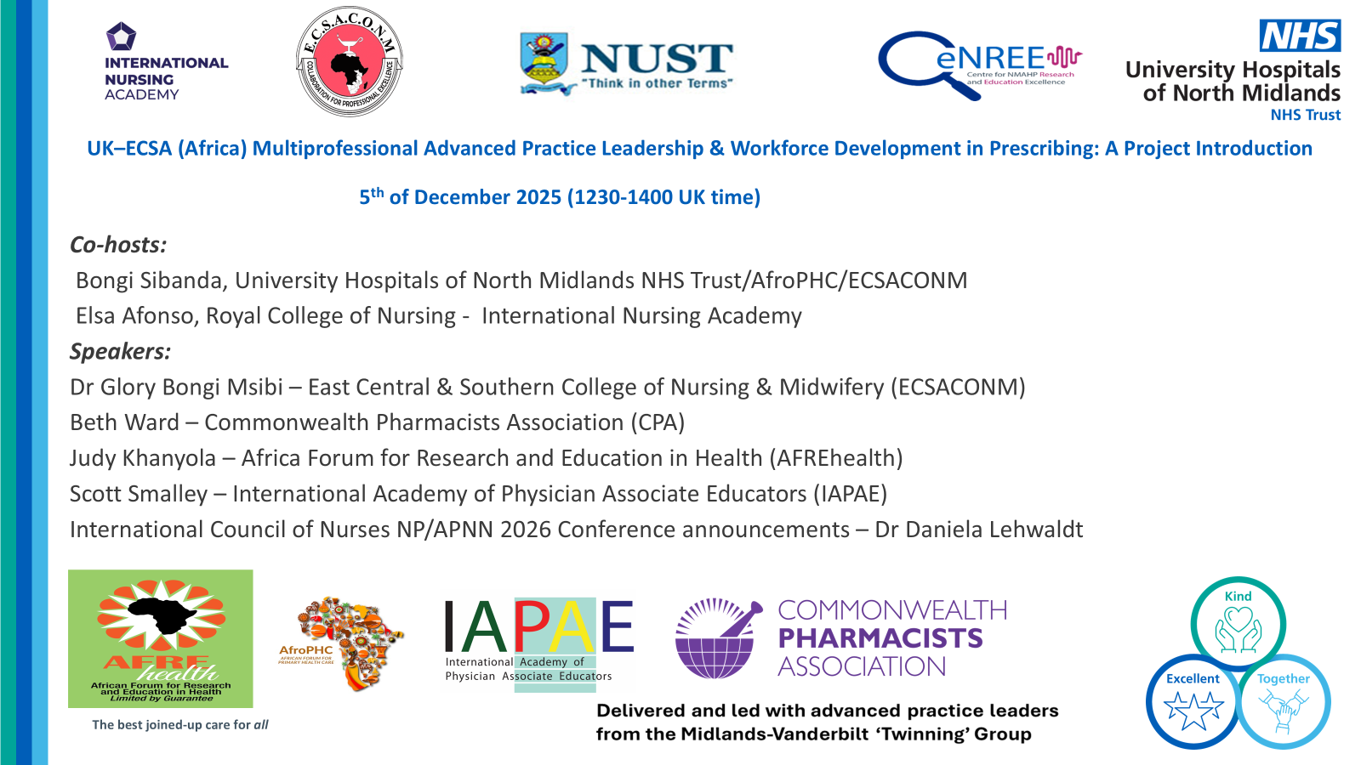
Global Centre for Multiprofessional Advanced Practice Leadership (Education, Policy & Innovation): Dec 2025-Dec 2027
The African Forum for Research and Education in Health (AFREhealth) as lead for International Universities and Institutions collaboration
Overall governance for health professions education, research and innovation programmes of work
Support governance structures through ESCA College of Nursing and Midwifery (ECSA Health Community) and AfroPHC (for all primary care-related workstreams)
UK coordinating higher education institution (TBC)

Slide 18
Education and Workforce
Development Perspectives
AFREhealth

Slide 19

Judy Khanyola
Vice-President
AFREhealth
Kenya
Guest Speaker

Slide 20

Preparing the Health Workforce for Prescribing and Medicines Management
in African Primary Health Care
Judy N. Khanyola

Slide 21
An AFREhealth Lens on Workforce for Prescribing
Bongi has set the institutional frame. Beth has shown why expanded prescribing capacity is no longer optional in Africa.
My job in the next 15 minutes is to answer the workforce question that sits underneath both: how do we train, prepare and sustain the people who will actually prescribe — safely, at scale, and in our context?
I will frame this conversation through three questions AFREhealth puts to every workforce decision:
Is it cost-effective for African health systems?
Does it harmonise across our fragmented landscape?
Does it respect African contextual realities?

Slide 22
Policies have moved.
Workforce preparation has not kept pace.
What policy allows:
What training delivers:
Expanded scopes of practice across several African countries
Non-physician prescribing recognised for nurses, pharmacists, advanced practitioners
Primary health care (PHC)-led service delivery models backed by national strategies
Task-sharing endorsed by WHO and regional bodies
Pre-service curricula slow to recognise expanded roles
Few structured prescribing programmes for nurses and pharmacists
Limited supervised practice, mentorship, and CPD pathways
Interprofessional learning largely absent from training environments
The gap between mandate and competence is the workforce question.

Slide 23



Three Questions for Every Workforce Investment
1) Training that returns more health than it costs
African systems run on lean budgets. Every dollar of pre-service and in-service training must show measurable returns in coverage, quality and retention.
2) Standards that travel across borders
Fragmented curricula, regulation and accreditation slow workforce mobility and waste investment. Harmonization is the multiplier — within countries and across the continent.
3) Training designed for African realities
Disease burden, supply chains, regulatory maturity and cadre mix vary across our 54 countries. Generic models break on contact with our systems.

Slide 24
Workforce training is the highest-leverage health investment we are not making at scale.
9x
return on every dollar invested
in health workforce education
and employment
(WHO/Lancet Commission)
44%
of WHO Member States report
fewer than 1 medical doctor per 1,000 population — Africa carries
the deepest gap
1:3
ratio of training a nurse prescriber relative to the cost of equivalent physician-led care delivery
What this means for prescribing training:
Train at the cadre level where prescribing actually happens — nurses and pharmacists in PHC.
Embed CPD into the job, not as a one-off course. Short, structured, supervised, repeated.
Stop paying twice — for fragmented donor curricula and again to retrain when staff move countries.

Slide 25
Fragmentation is the tax we pay for every uncoordinated training programme.
Where the fragmentation sits:
The cost we’re paying:
Curricula: Each country writes prescribing curricula from scratch — same competencies, 54 versions.
Regulation: Scope of practice for nurse and pharmacist prescribing varies country to country, sometimes facility to facility.
Accreditation: No common quality benchmark for prescribing programmes. Graduates cannot move; employers cannot trust.
CPD systems: CPD requirements differ by regulator, creating duplication and gaps.
Workforce cannot move legitimately across borders — even within Regional Economic Communities
Donors fund parallel curricula in neighbouring countries
Quality varies dramatically; patients carry the risk
Continental-scale benefits never materialise

Slide 26
Building Continental Architecture for
Health Professions Education
Selected AFREhealth instruments relevant to prescribing and medicines management:
AHPEQS - Africa Health Professions Education Quality Standards
Common accreditation framework for nursing, medical and pharmacy education — so a programme accredited in Kigali means the same in Kumasi or Nairobi.
MHRHL - Master's in Health Research and Health Leadership Curriculum
WHO Africa Region consensus curriculum — demonstrating that pan-African competency frameworks can be agreed, harmonised and delivered.

Slide 27
There is no single ‘African’ prescribing context.
Disease
burden
Non-communicable disease dominance in urban Kenya vs. malaria dominance in rural West Africa.
Supply
chain
Predictable national supply vs. frequent stock-outs and parallel imports.
Regulatory maturity
Active prescribing regulators vs. councils still drafting frameworks
Cadre
mix
Nurse-led PHC in Rwanda vs. pharmacist-led models in Zimbabwe.
Training
capacity
Established pharmacy/nursing schools vs. emerging institutions.
Continental standards must be adaptable. Country implementation must be sovereign.
"One size fits Africa" curricula imported wholesale fail every time.

Slide 28
What Prescribing Training Should Look Like:
Cost-Effective, Harmonised, Content-Anchored
1) Competency-based, not time-based
Define the prescribing competencies a nurse or pharmacist must demonstrate. Train and assess against those — not against hours of attendance.
2) Interprofessional from day one
Pharmacy and nursing students learn medicines management together. Real prescribing decisions are made in teams — training should be too.
3) Workplace based, with supervision
Move learning into PHC facilities. Pair structured curricula with named supervisors, logbooks, and progressive responsibility.
4) Built once, adapted locally
Continental competency framework. Country-level adaptation for disease profile, formularies, regulation. Mutual recognition between systems.

Slide 29
Prescribing is a team behaviour.
Training must mirror practice.
Shared learning environments
  Nursing and pharmacy students taught medicines management in the same classroom and clinical placement.
Common competency framework
  Agreed prescribing competencies across cadres: different scopes, same patient-safety standards.
Joint CPD and case review
  PHC teams continue learning together post-qualification. Cases reviewed multi-professionally.
Co-developed regulation
  Pharmacy and nursing councils harmonise prescribing scopes — not in parallel silos.
PATIENT
SAFE
PRESCRIBING
NURSE
PHARMACIST

Slide 30
Five Moves to Strengthen Prescribing Workforce Development in Africa
Agree continental prescribing competencies
Through AFREhealth, ECSA, CPA, and the regional regulatory councils — define the core prescribing competencies for nurses and pharmacists. One framework, country adaptation.
Accredit programmes against harmonised standards
Use AHPEQS-aligned quality benchmarks for every prescribing programme on the continent. So a graduate from Kampala, Lusaka, or Lagos means the same thing.
Invest in supervised workplace-based training
Funding shifts from didactic short courses to structured supervision in PHC facilities. Mentor capacity is itself a training investment.
Make interprofessional education the default, not the innovation
Pharmacy and nursing schools co-deliver medicines management training. Build the team in the classroom before deploying it in the clinic.
Build the evidence - and own it
African-led research on cost-effectiveness, retention, and patient outcomes of expanded prescribing roles. End reliance on imported evidence for local decisions.

Slide 31
Africa's prescribing workforce will not be built by accident
— or by import.
It will be built by African institutions training African professionals to harmonised standards for African patients — at a cost our systems can sustain.

Slide 32
Country Case Studies
Commonwealth Pharmacists Association

Slide 33
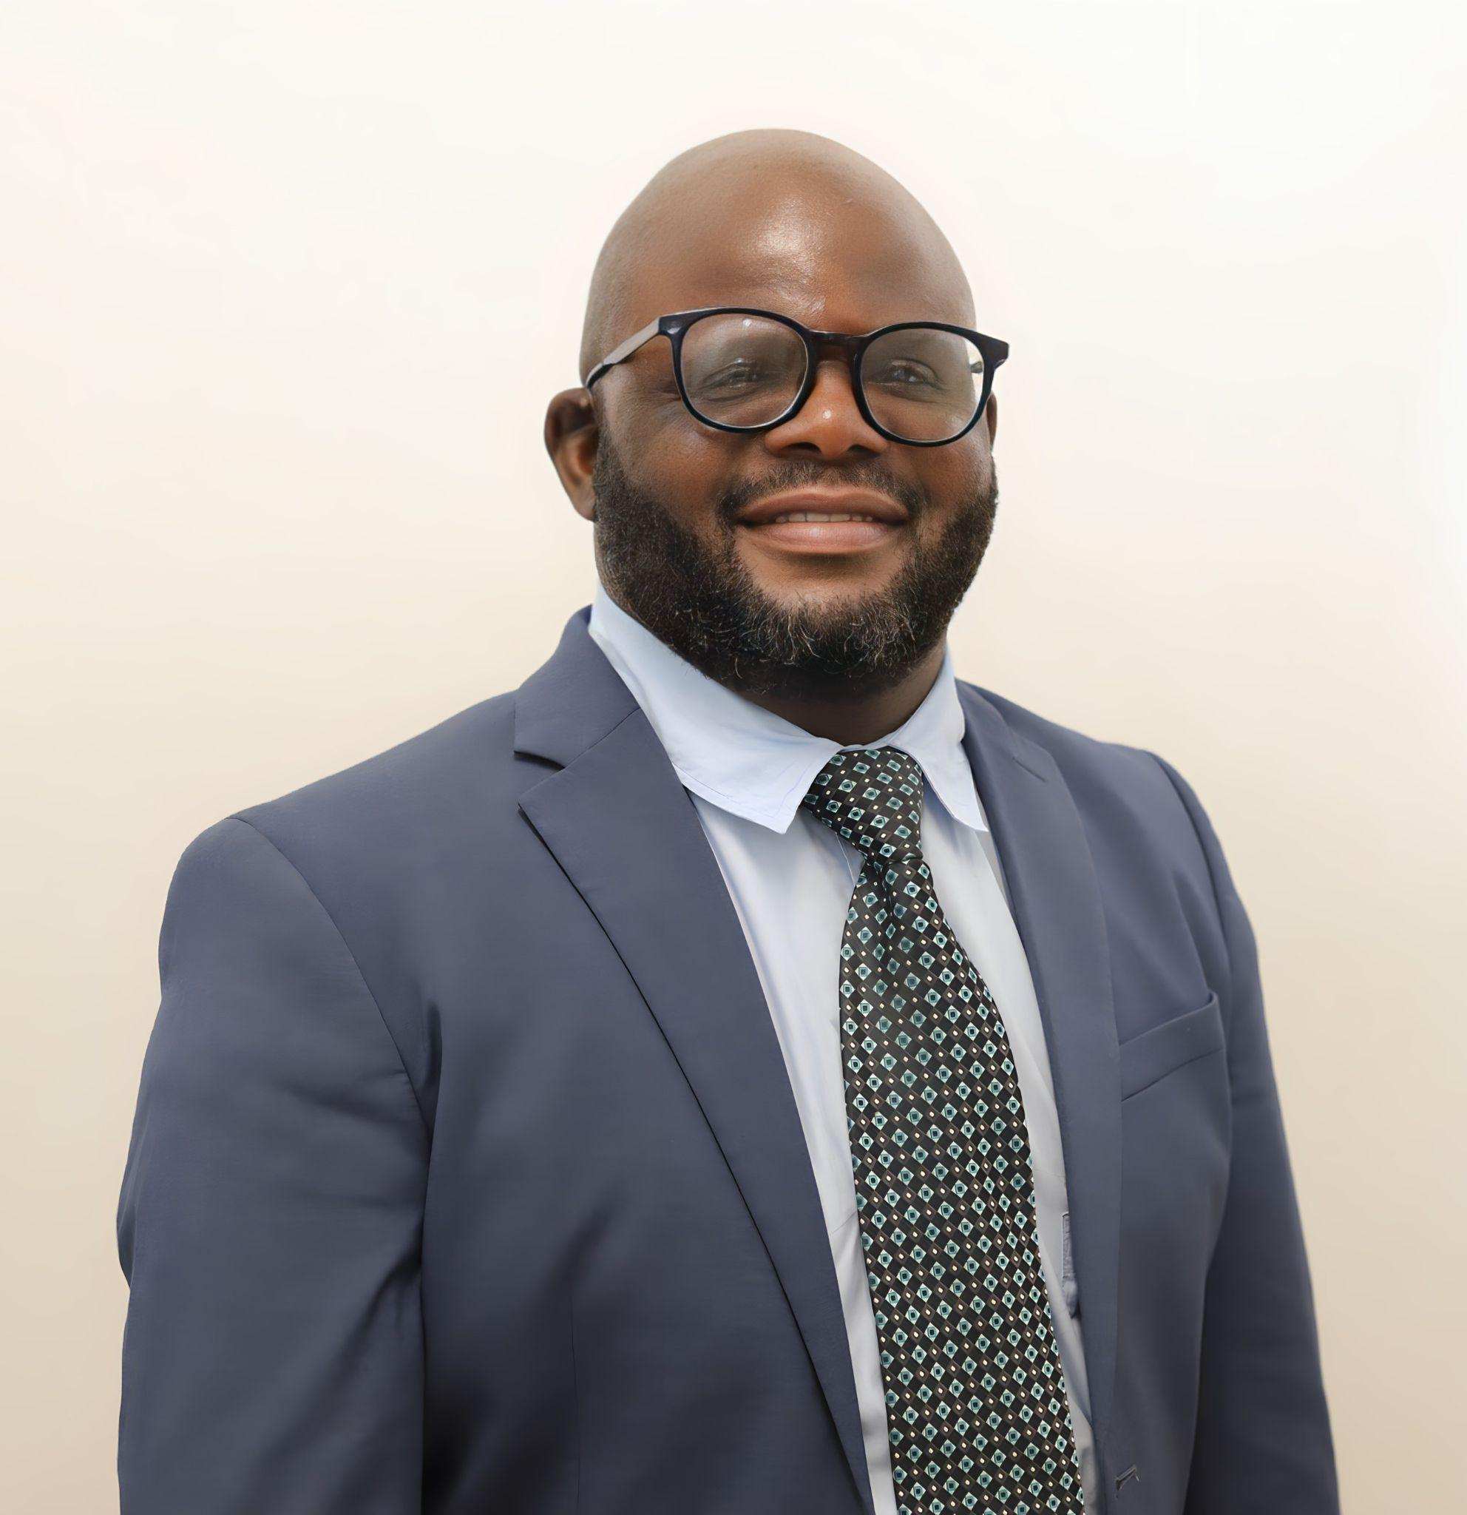
Gift T. Chareka
Past President
Pharmaceutical Society of Zimbabwe
Zimbabwe
Guest Speaker

Slide 34

Pharmacists in Zimbabwe: Medicines Management & Prescribing Landscape
Gift T. Chareka (R.Ph, MPS)

Slide 35

Medicine Management & Pharmaceutical Care
Custodians of Medicines
  Safeguarding supply chain integrity
Clinical Review
  Monitoring patient charts for interactions, contraindications, adverse drug reactions
Rational Drug Use for Short-Term and Chronic Illnesses
  Supporting HIV/AIDS programmes, hypertension, diabetes, rheumatoid arthritis, oncology
Inventory & Cold Chain
  Managing vaccines/biologics and all temperature sensitive medicines
Patient Counseling
  Promoting and monitoring treatment adherence for better patient outcomes

Slide 36
Current Prescribing Landscape
Governance
  Medical Aid Society of Central Africa and Medicines Control Authority of Zimbabwe oversight
Traditional Scope
  Dispensing and over-the-counter recommendations
Primary Care Role
  First contact for minor ailments/emergencies
Pharmacist-Initiated Medicines
  Emerging framework under current protocols
    PHASE Z (pharmacy-led HIV prevention, implementation research will be led by the Ministry of Health and Child Care and supported by funding partners, and involvement in the Expanded Programme on Immunization)

Slide 37
Evolving Prescribing Initiatives
HIV Prevention
  Community pharmacists prescribing of pre-exposure prophylaxis (PrEP) and post-exposure prophylaxis (PEP)
Vaccination
  Prescribing and administration of vaccines within community pharmacies
Strategic Goal
  Expanded pharmacist prescribing to strengthen PHC to cement universal health coverage (UHC)

Slide 38
Implications for Proposed SI 330 of 2000
(Medical Aid Societies Regulations)
Prohibition of medical insurance companies from offering health services
  All local key stakeholders are involved in this discussion to agree on the most pragmatic and patient-favorable recommendation
Potential impact:
  Restructuring of service delivery models
  Greater reliance on public sector and professional associations
  Expanded pharmacist role in PHC
  Need for stronger regulatory and financing frameworks

Slide 39
Conclusion
Pharmacists are central to medicine management and patient safety.
Prescribing rights are expected to evolve in the near future (PrEP, PEP, vaccination).
Proposed policy shifts may accelerate pharmacist integration into PHC.
Multi-professional collaborations are essential for sustainable prescribing capacity.

Slide 40
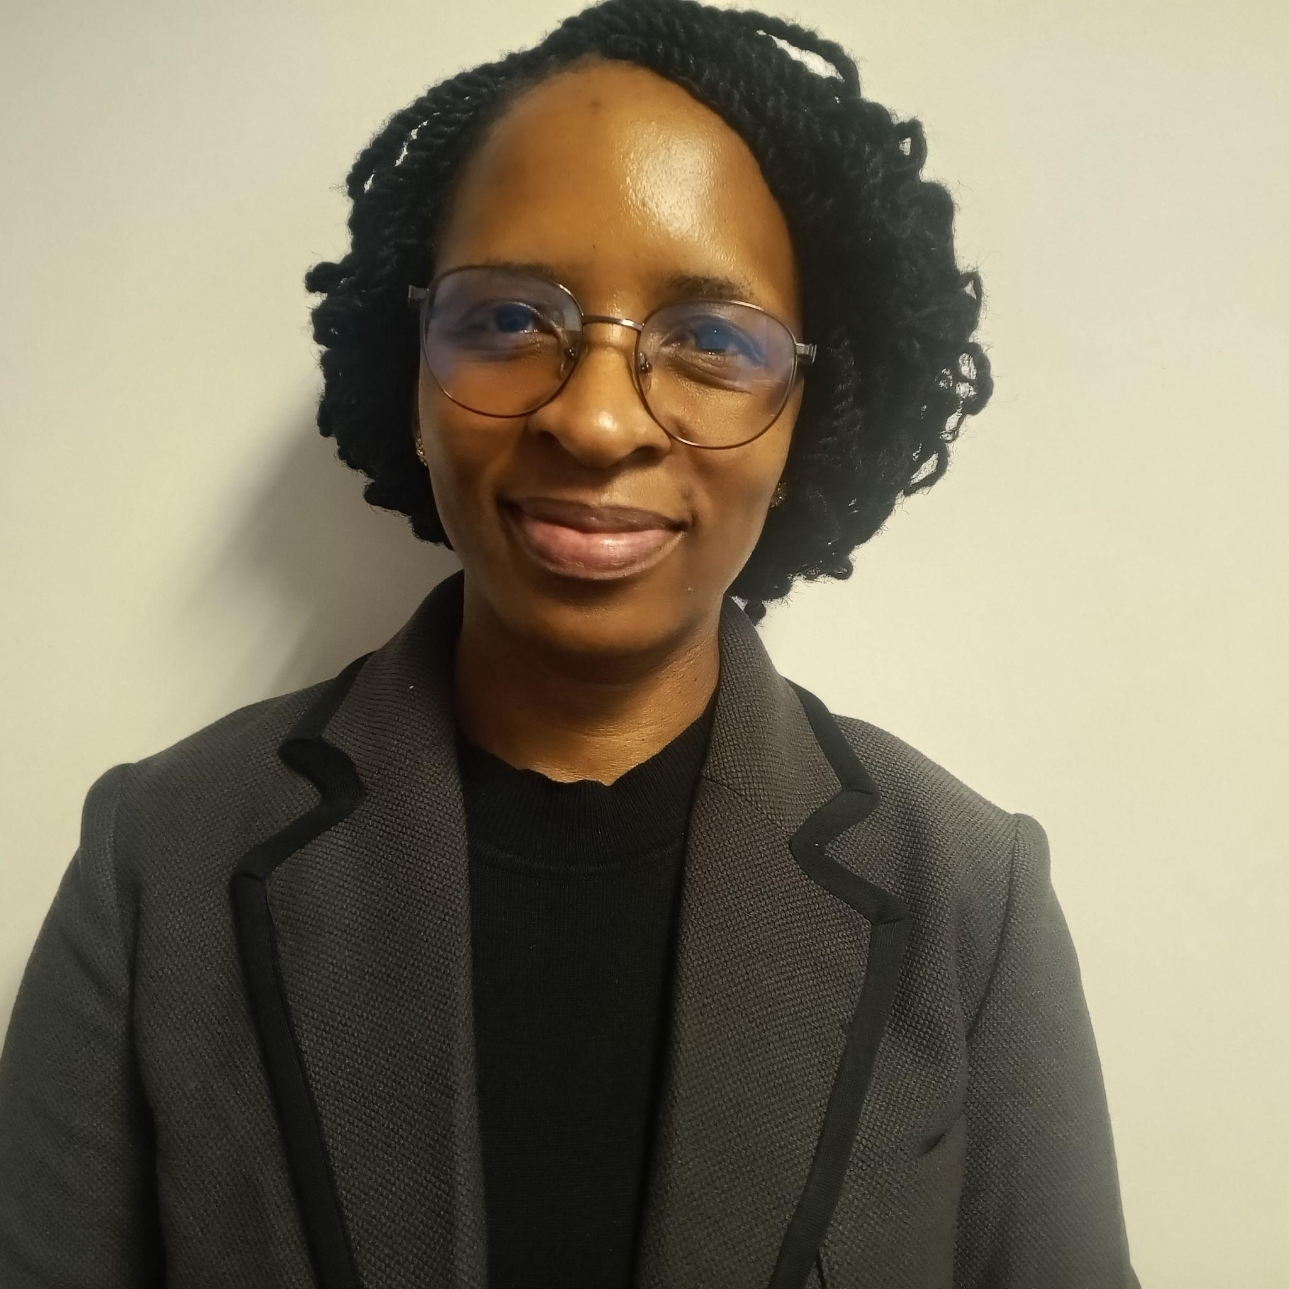
Seeletso Ndicky Modibedi
Family Nurse Practitioner and Lecturer
Institute of Health Sciences - Serowe
Botswana
Guest Speaker

Slide 41

Workforce Training Models:
Botswana Case Study
Modibedi S. N. (MNS-FNP, BNS)

Slide 42

Objectives
Discuss workforce training models (WTMs) supporting family nurse practitioner (FNP) prescribing in PHC
Examine the alignment of competency-based education with the national health needs and FNP prescribing competence
Analyse the strengths and challenges of WTMs affecting FNPs’ prescribing in Botswana

Slide 43
Overview
Global PHC systems face critical workforce shortages.
Nurse prescribing roles are expanding worldwide.
Botswana, like other lower-middle-income countries, is alive to these global trends (Nkomazana et al, 2014)

Slide 44
WTMs
A competency-based model that aligns nursing education with the immediate needs of the population to ensure nurses safely prescribe and manage outcomes
(Mlauzi, Goel & Molosiwa, 2025)

Slide 45
WTMs
NATIONAL HEALTH NEEDS
POLICY & REGULATORY FRAMEWORKS
TRANSITION TO PRACTICE
EDUCATION (COMPETENCY-BASED CURRICULUM)
DEPLOYMENT IN PHC SETTINGS & CPD
HEALTH SYSTEMS OUTCOMES

Slide 46

WTMs Analysis
Strengths
Challenges
Competency-driven assessment
Continuity of care in PHC
Evidence-based prescribing
Regulatory gaps
Multi-body oversight challenges
Training surpasses regulatory frameworks

Slide 47
Conclusion
The Botswana experience demonstrates that a competency-based FNP training can strengthen PHC systems and promote health equity when education, policy and regulation, and clinical practice evolve together.

Slide 48
References
Medicines and Related Substances Act of 2013, Botswana
Ministry of Health. The Botswana 2023 Integrated HIV Clinical Care Guidelines
Ministry of Health(a). (2011). National Health Policy: ‘Towards a Healthier Botswana'. Gaborone: Ministry of Health.
Ministry of Health(b). (2016). BOTSWANA ESSENTIAL MEDICINES LIST 3RD EDITION ELECTRONIC VERSION: JUNE 2016. Ministry of Health.
Ministry of Health(c). (2016). Botswana Primary Care Guidelines for Adults
Mlauzi N.M., Goel S.R., Molosiwa D.S (2025) Reimagining Health Systems for Better Health: Strategic Recommendations for Strengthening Health Workforce in Botswana – A Qualitative Study. Texila International Journal of Academic Research. DOI 10.21522/TJIAR.2014.12.04.Art012
Nkomazana, O., Peersman, W., Willcox, M., Mash, R., & Phaladze, N. (2014). Human resources for health in Botswana: The results of in-country database and reports analysis. African Journal of Primary Health Care & Family Medicine, 6(1).
Statistics Botswana. (2022) Botswana AIDS Impact Survey V (BAIS V) 2021: Detailed Report. Gaborone, Botswana

Slide 49

Dr Wairimu Njuki
President
Pharmaceutical Society of Kenya
Kenya
Guest Speaker

Slide 50




CONTEXT
Africa's Health Imperative: The Case for Reform
📈 Rising NCD Burden
🦠 Antimicrobial Resistance
Diabetes, hypertension, cancer stretching primary care capacity beyond limits
Irrational prescribing driving resistance — a patient safety emergency
👥 Workforce Shortages
💊 Supply Chain Fragility
Africa faces a critical health workforce gap compounded by optimisation failures
Global medicines disruptions exposing structural vulnerabilities in PHC systems
Africa's challenge is not only workforce shortage — it is also workforce optimisation and regulatory clarity.
Dr. Wairimu Njuki Mbogo | President, PSK | ECSA MDT Webinar · 13 May 2026
PSK · EPIC: Education · Policy · Innovation · Collaboration
Notes:
2

Slide 51
REGULATORY FRAMEWORK
Scope of Practice: A Patient Safety Instrument
✗ What It Is NOT
✔ What It IS
✗ Professional protectionism
✔ A clinical governance tool
✗ Turf warfare between professions
✔ A patient safety mechanism
✗ A barrier to expanded access
✔ A healthcare quality framework
✗ A trade union position
✔ A competency-accountability match
"Collaboration without clarity creates risk. Collaboration with clarity strengthens healthcare systems."
Dr. Wairimu Njuki Mbogo | President, PSK | ECSA MDT Webinar · 13 May 2026
PSK · EPIC: Education · Policy · Innovation · Collaboration
Notes:
3

Slide 52
KENYA CASE STUDY
Kenya's Reform Agenda: Five Pillars of Change
1
HCP Policy 2026
Workforce differentiation aligned to ISCO-08 classification — right person, right role, right oversight
2
Scope of Practice
Pharmacist prescribing governance & competency-based frameworks anchored in patient safety
3
Medicines Scheduling
Risk-based scheduling: matching medicine risk to the level of professional oversight required
4
GPP Reform (PPB)
Good Pharmacy Practice standards raising service quality and accountability across all settings
5
Medicines Optimisation
AMR stewardship, chronic disease management & safe prescribing at primary care level
PSK has made formal submissions to Kenya's Ministry of Health on all five pillars, each anchored in patient safety.
Dr. Wairimu Njuki Mbogo | President, PSK | ECSA MDT Webinar · 13 May 2026
PSK · EPIC: Education · Policy · Innovation · Collaboration
Notes:
4

Slide 53
MEDICINES MANAGEMENT
Medicines Scheduling: Matching Risk to Oversight
S1–S2
General Sale / Pharmacy Sale
LOW CLINICAL RISK
S3–S4
Pharmacist Oversight Required
MODERATE RISK
S5–S6
Prescriber / Collaborative Prescribing
SIGNIFICANT RISK
S7–S8
Specialist Prescribing Only
HIGH CLINICAL RISK
← Low Risk INCREASING CLINICAL RISK → High Risk
Dr. Wairimu Njuki Mbogo | President, PSK | ECSA MDT Webinar · 13 May 2026
PSK · EPIC: Education · Policy · Innovation · Collaboration
Notes:
5

Slide 54
PHARMACY IN PRIMARY HEALTHCARE
The Pharmacist as PHC Partner
💊 Medicines Optimisation
🛡️ AMR Stewardship
📋 Prescribing Governance
Chronic disease, deprescribing, polypharmacy & adherence support
Rational antibiotic use, prescriber support, resistance surveillance
Collaborative prescribing, structured clinical protocols, safe systems
🖥️ Digital & Telepharmacy
⚕️ Patient Safety
🎓 Education & CPD
Remote PHC reach, digital records, underserved community access
Medication review, adverse event prevention, medicines reconciliation
Health literacy, community training, continuing professional development
The pharmacist is specifically trained to optimise medicines use.
Dr. Wairimu Njuki Mbogo | President, PSK | ECSA MDT Webinar · 13 May 2026
PSK · EPIC: Education · Policy · Innovation · Collaboration
Notes:
6

Slide 55
CLINICAL LEADERSHIP
Where Pharmacy Leads: AMR & Chronic Disease
🦠 Antimicrobial Resistance
💊 Chronic Disease Management
  Pharmacist-led antibiotic stewardship programmes
  Medicines optimisation for DM, HTN, asthma, COPD
  Point-of-care rational prescribing guidance
  Medication therapy management and structured reviews
  Medicines scheduling enforcement at dispensing
  Collaborative prescribing in NCD protocols
  Community AMR awareness and health literacy
  Deprescribing and polypharmacy management
  Surveillance data contribution to national AMR plans
  Patient adherence support and self-management tools
Dr. Wairimu Njuki Mbogo | President, PSK | ECSA MDT Webinar · 13 May 2026
PSK · EPIC: Education · Policy · Innovation · Collaboration
Notes:
7

Slide 56
INTERPROFESSIONAL COLLABORATION
Collaborative MDT Model: Clarity Enables Partnership
💊
🩺
👨‍⚕️
🏛️
Pharmacist
Nurse / APN
Physician / MO
Regulator / MOH
Medicines optimisation
Prescribing governance
Antimicrobial stewardship
Patient safety systems
Clinical assessment
Patient monitoring
Treatment initiation
Care coordination
Diagnosis
Complex case management
Specialist referral
Clinical leadership
Enabling frameworks
Competency standards
Accountability
Policy governance
"Every professional has a defined, valued role. Clarity is not competition — it is the foundation of safe teamwork."
Dr. Wairimu Njuki Mbogo | President, PSK | ECSA MDT Webinar · 13 May 2026
PSK · EPIC: Education · Policy · Innovation · Collaboration
Notes:
8

Slide 57
PSK'S EPIC FRAMEWORK
Driving Continental Reform in Pharmacy Practice
E
P
I
C
Education
Policy Advocacy
Innovation
Collaboration
Pre-service and continuing professional development aligned to competency frameworks and evolving PHC needs
Evidence-based engagement with governments, regulators and international bodies on pharmacy reform
Championing telepharmacy, digital health, new service models and pharmaceutical care evolution
Building sustainable MDT partnerships across nursing, medicine, public health and global health partners
"PSK Vision: Defining and advancing the highest attainable standard of health through pharmaceutical care."
Dr. Wairimu Njuki Mbogo | President, PSK | ECSA MDT Webinar · 13 May 2026
PSK · EPIC: Education · Policy · Innovation · Collaboration
Notes:
9

Slide 58


AFRICA. THE TIME IS NOW.
Every healthcare reform must move us
closer to the highest attainable
standard of health.
1
Advance regulatory frameworks that match competency to clinical risk
2
Invest in pharmacists as PHC partners — not peripheral dispensers
3
Build MDT systems with clarity, accountability and shared purpose
4
Champion medicines optimisation as a continental patient safety priority
Dr. Wairimu Njuki Mbogo | President, Pharmaceutical Society of Kenya (PSK)
www.psk.or.ke · president@psk.or.ke
Notes:
10

Slide 59

PSK IN ACTION
46TH PSK
ANNUAL SCIENTIFIC
CONFERENCE 2026
Theme:
Pharmacists Leading Transformation and Innovation Towards the Highest Attainable Standards of Health
24th-26th June 2026
PrideInn Paradise, Mombasa
Notes:
10

Slide 60

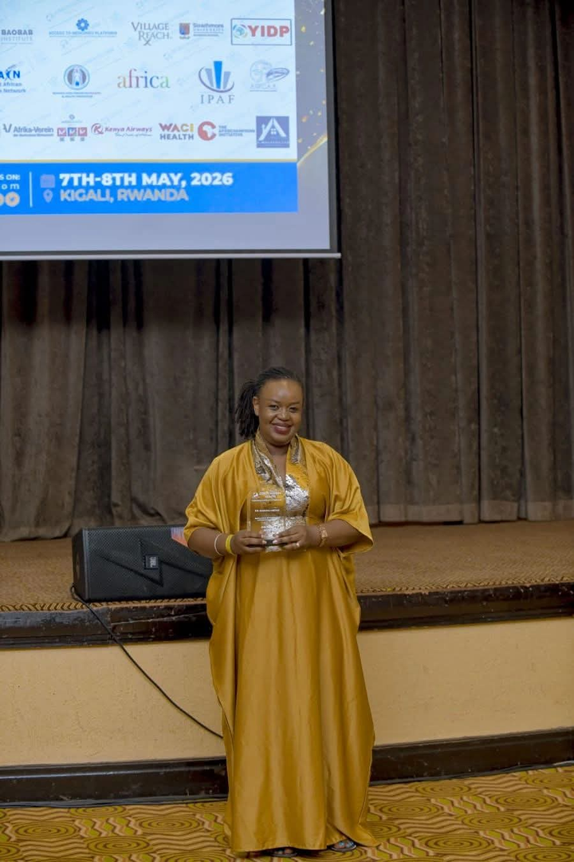
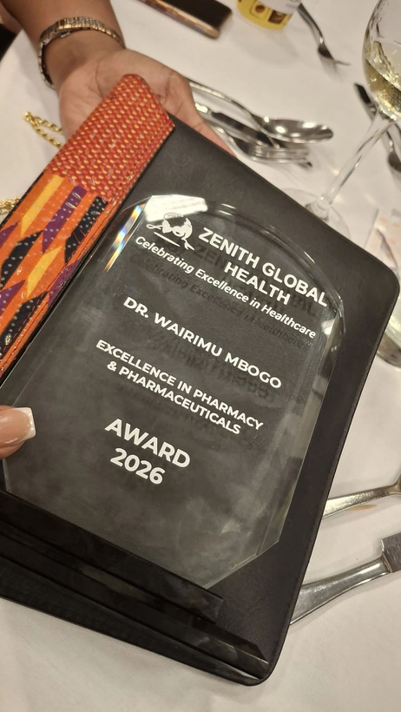
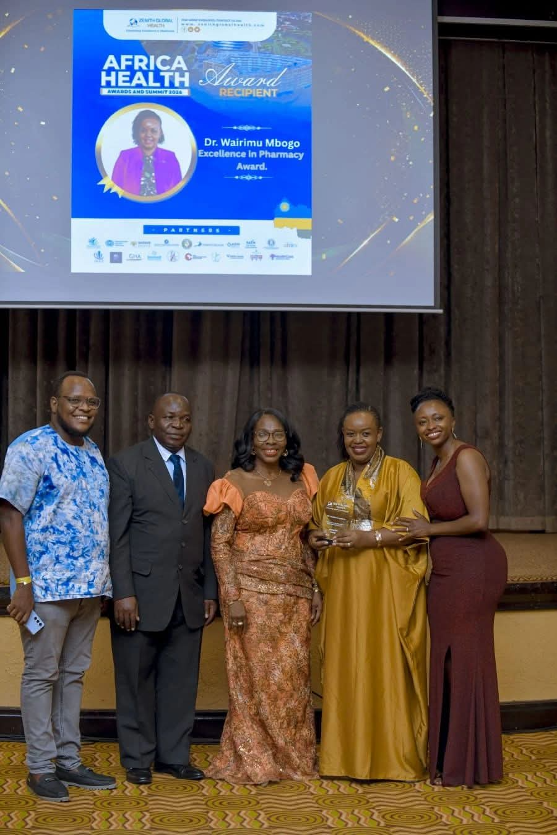
RECOGNITION & AWARD
Notes:
10

Slide 61

Dr Lizemari Hugo
Associate Professor
University of the Free State
South Africa
Guest Speaker

Slide 62

Prescribing & Medicines Management in Primary Care:
A South African Perspective
Dr Lizemari Hugo

Slide 63


The South African Healthcare Context
? The role of the PHC Nurse
? Interdisciplinary approach
? Legislative reform needed
? Training on prescription and medicine management
(Moosa, 2019)
Referral Hospital
Tertiary level
District hospital
Secondary level
Health centre
Primary level
Community level

Slide 64
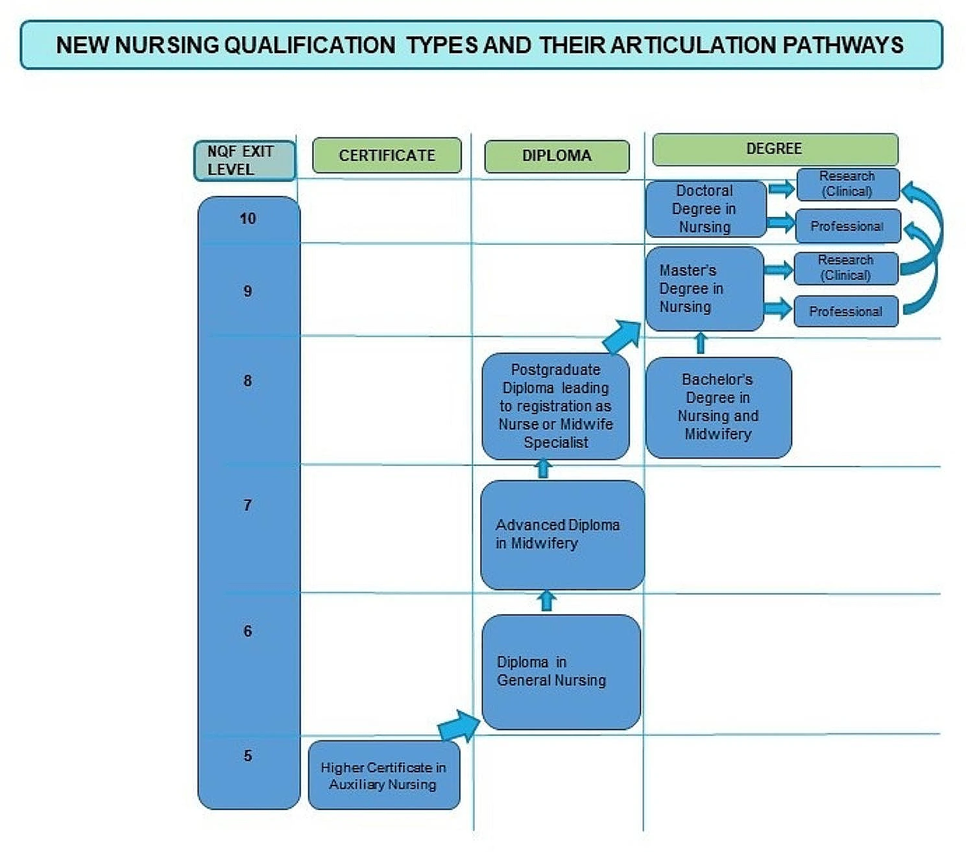
Nursing Context in South Africa
Train for other African countries
Not South African Nursing Council recognised
Advance Practice Nurses
Post-graduate diploma in the specific specialisation
(Matahela, & Makhanya, 2024)
Nursing Act (No. 33 of 2005) & Medicines and Related Substances Act (No. 101 of 1965)

Slide 65




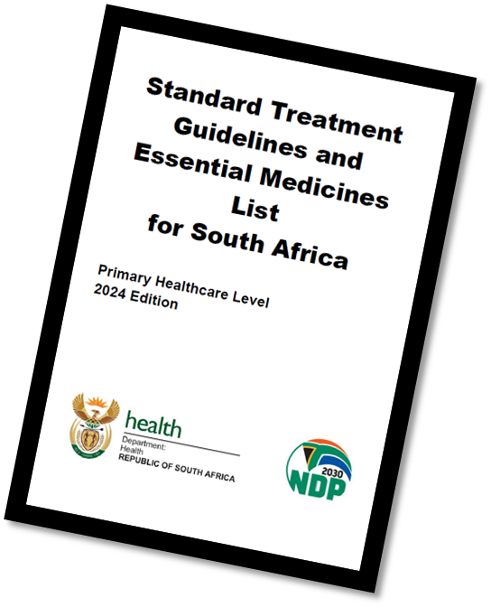
Interprofessional Team in The PHC Workforce
Safe patient care
UHC
National health insurance

Slide 66
Clinical Supervision
Under and postgraduate training
CPD
Competency-based curriculums
Work-based learning
Increased supervision time by preceptors & educators
Smaller preceptor:student ratios
*Preceptors appointed by nursing education institutions cannot prescribe in PHC facilities
*Clinical speciality and nursing education
Competency-based programmes
Regulatory compliant
Address training needs

Slide 67
Clinical Supervision for Success
Interprofessional approach is needed
Preceptorship training to facilitate learning
Cross supervision to support learning

Slide 68
Reference List
Delobelle, P. (2013). The health system in South Africa. Historical perspectives and current challenges. South Africa in focus: Economic, political and social issues, 159-205.
Matahela, V. E., & Makhanya, N. J. (2024). Towards a national policy on nursing education and training: an imperative framework for integrating nursing education within South Africa’s post-school education system. BMC Nursing, 23(1), 286.
Moosa, S. (2019). Achieving universal health coverage in South Africa through a district health system approach: conflicting ideologies of health care provision. Available form: https://profmoosa.com/achieving-universal-health-coverage-in-south-africa-through-a-district-health-system-approach-conflicting-ideologies-of-health-care-provision/ Date accessed: 05/05/2026
South African Nursing Council. (2012). Advance Practice Nurses. Available from: https://www.sanc.co.za/advanced-practice-nursing/ Date accessed: 05/05/2026
South African Nursing Council. (2020). Education and training guidelines for Postgraduate diploma programmes. Available from: https://www.sanc.co.za/wp-content/uploads/2020/08/Education-and-Training-Guidelines-for-Postgraduate-Diploma-Programmes.pdf Date accessed: 05/05/2026

Slide 69
Moderated Panel Discussion
AFREhealth | ECSA Health Community | Commonwealth Pharmacists Association

Slide 70
Gift T. Chareka
Dr Lizemari Hugo
Judy Khanyola
President
Pharmaceutical Society of Zimbabwe
Associate Professor
University of the Free State
Vice-President
AFREhealth
Seeletso Ndicky Modibedi
Dr Wairimu Njuki
Family Nurse Practitioner and Lecturer
Institute of Health Sciences - Serowe
President
Pharmaceutical Society of Kenya

Slide 71
Closing Remarks
AFREhealth | ECSA Health Community | Commonwealth Pharmacists Association

Slide 72
ECSA Prescribing and Medicines Management Webinar
Commonwealth Pharmacists Association

